Slide 1
Tennis Gambling Analytics
How to Handle Your Bets
Cate Capiak | Nick Kurtansky | Ashton Pallottini | Jacob Schmitter | William Renius | Yifei Yan

Slide 2
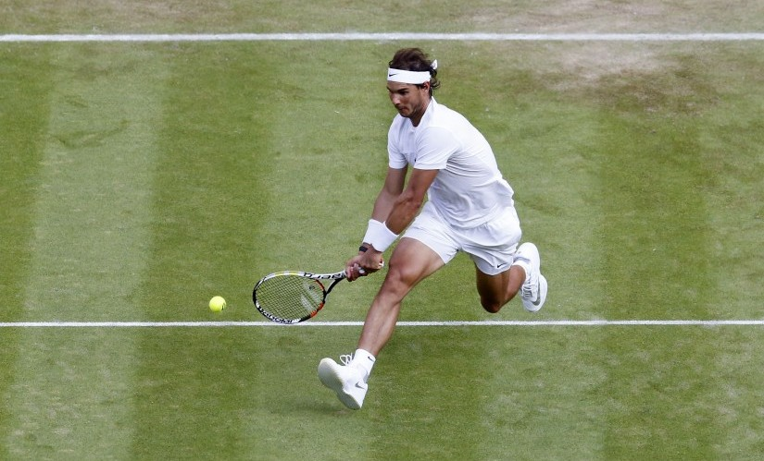
Table of Contents
Tennis gambling introduction
Baseline betting strategies
Exploration & training analysis
Informed betting Strategies
Basic conditional method
Single-player logistic regression method
Overall regression method
SVM method
Adaboost method
Random Forest method
Next Steps

Slide 3
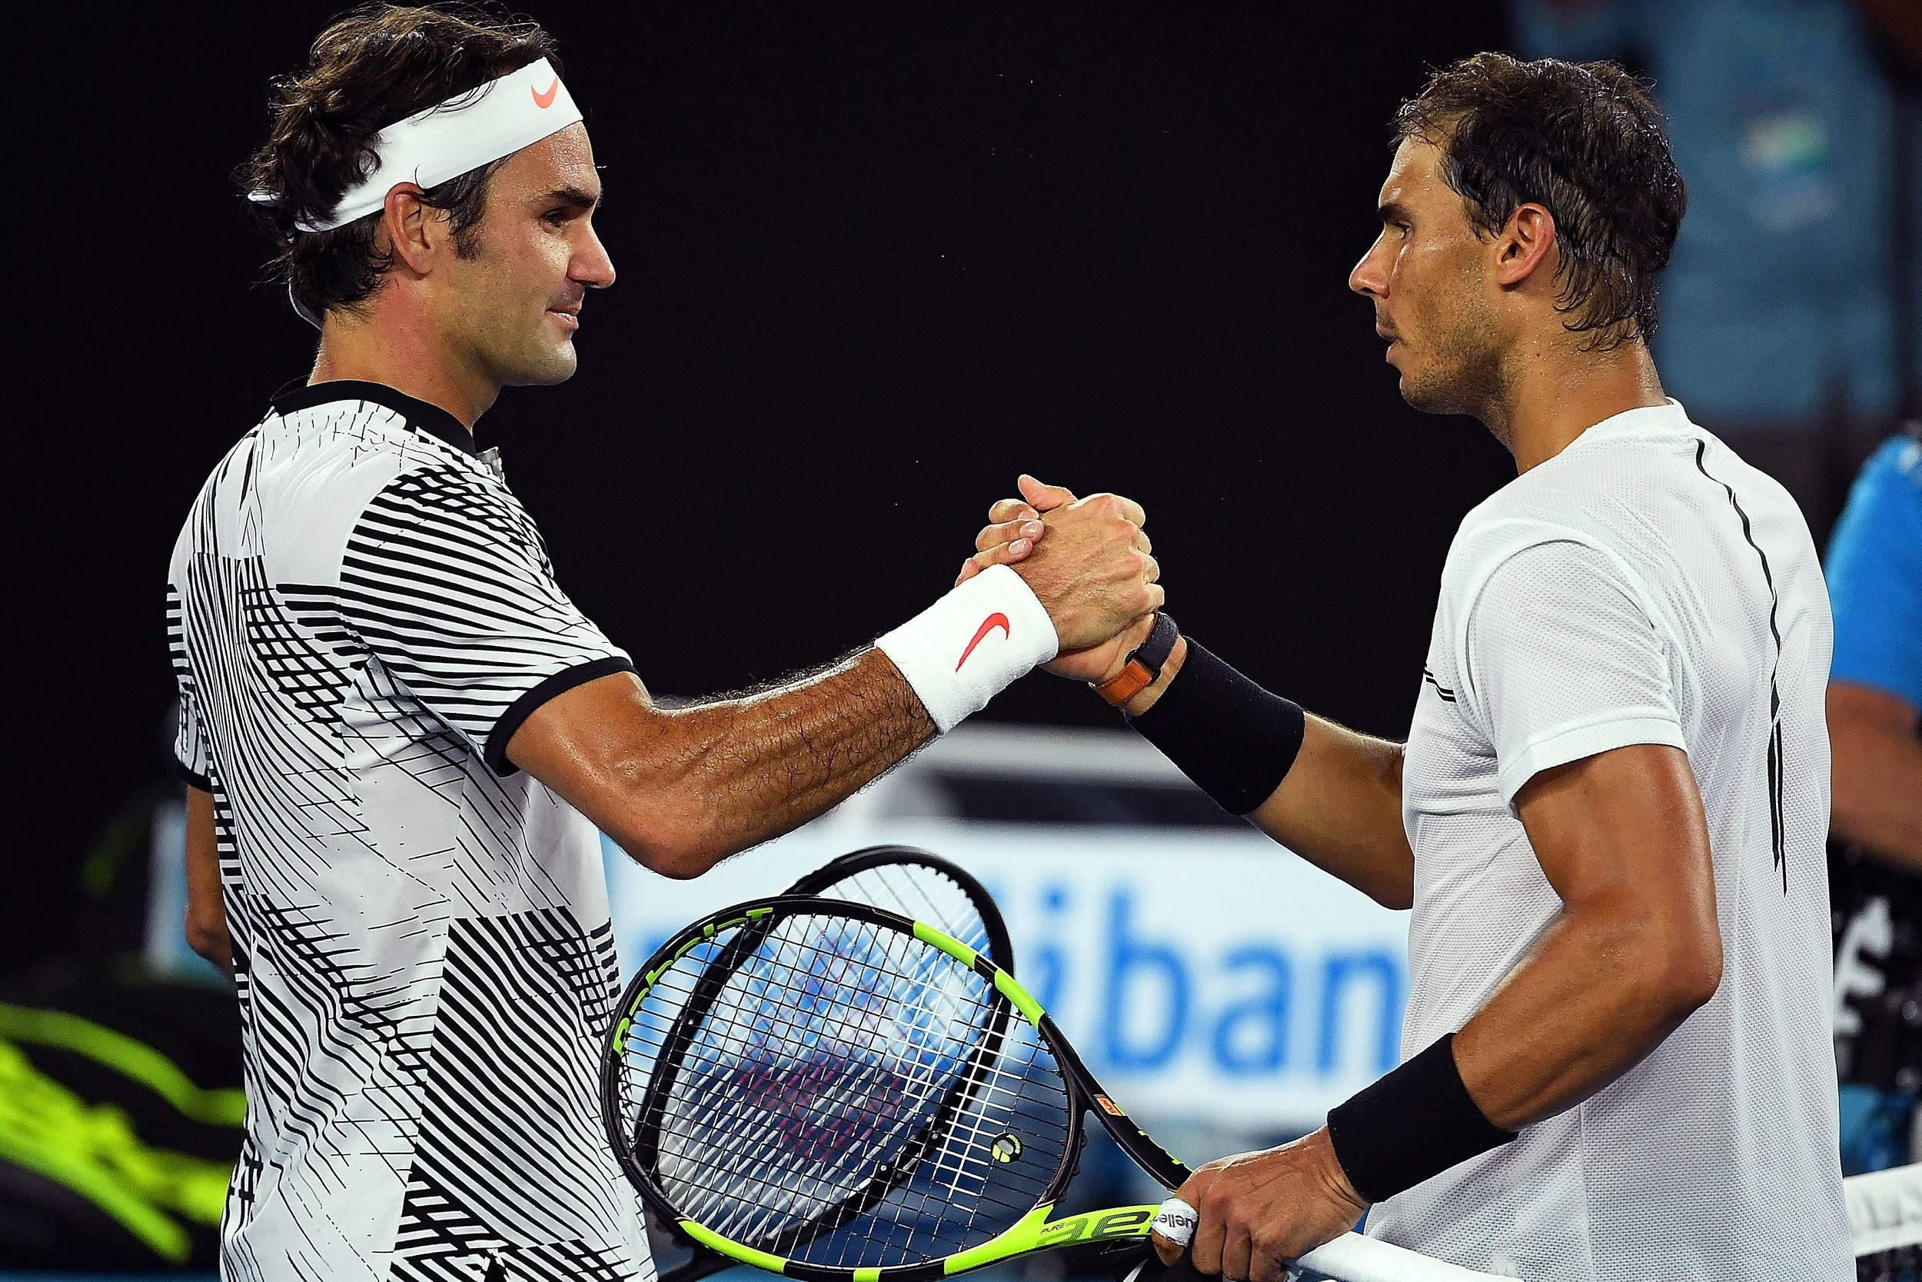
2017 Australian Open Final
 | World Rank | Odds
Rafael Nadal | 9 | 1.75
Roger Federer | 17 | 2.25
$100 bet on Nadal could result in $75 profit
$100 bet on Federer could result in $125 profit
(Roger Federer actually won the match)

Slide 4
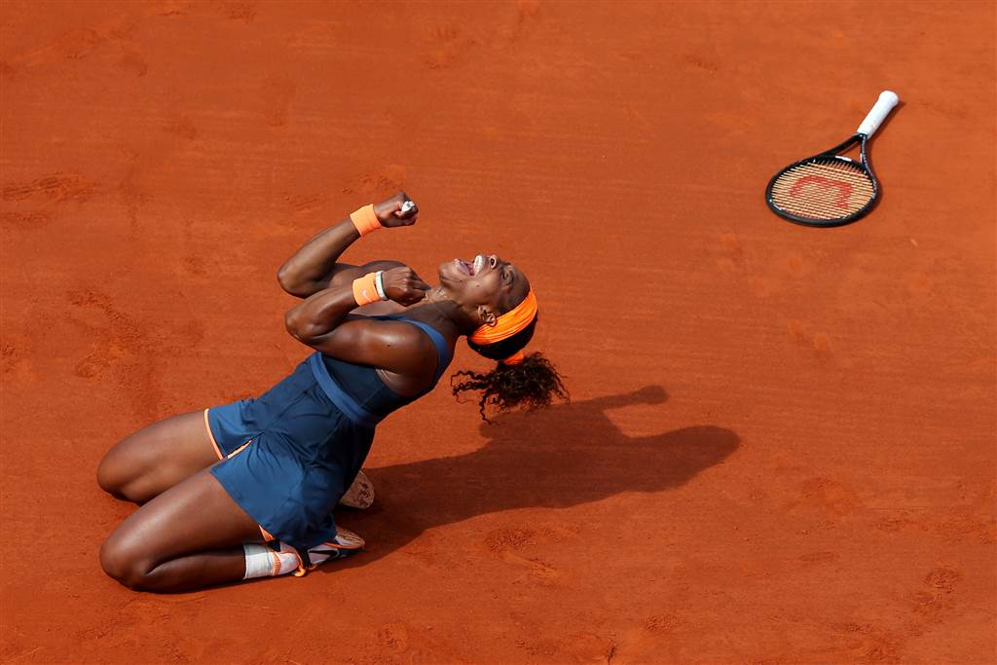
Our Data
Source: Tennis-Data.co.uk
Years: 2001 through 2017
Variables:
Date and location
Series/tournament name
Match type (best of ⅗ games)
Court surface type
Round of tournament
Player names
Player rankings
Betting Odds from various UK sports books

Slide 5
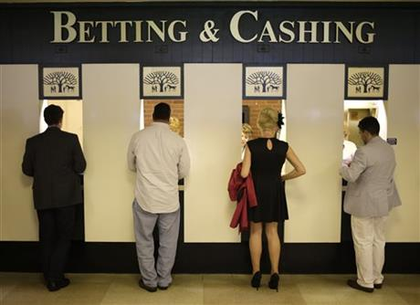
Baseline Betting Strategies
Always bet favorite
Always bet underdog
Always bet higher (better) rank
Always bet lower (worse) rank
Randomly choose between underdog and favorite

Slide 6
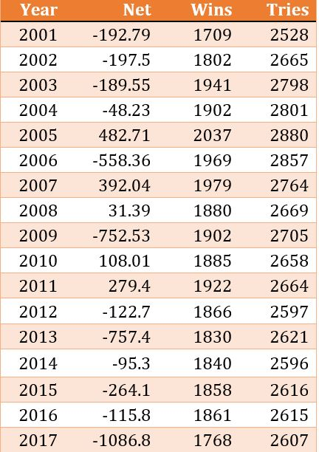
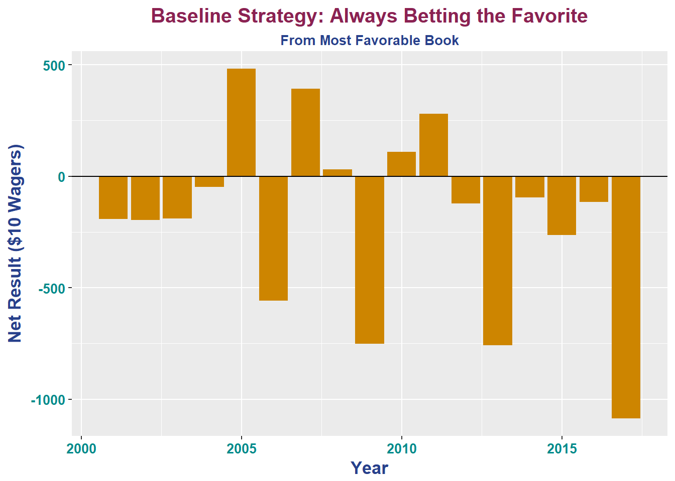
Baseline: Always Bet the Favorite

Slide 7
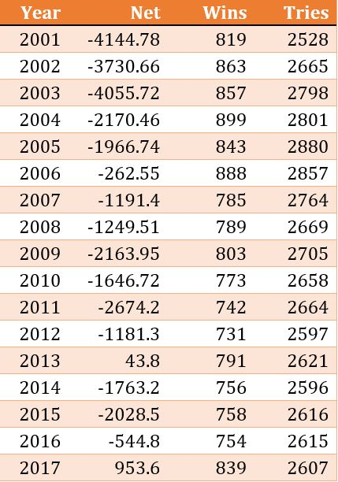
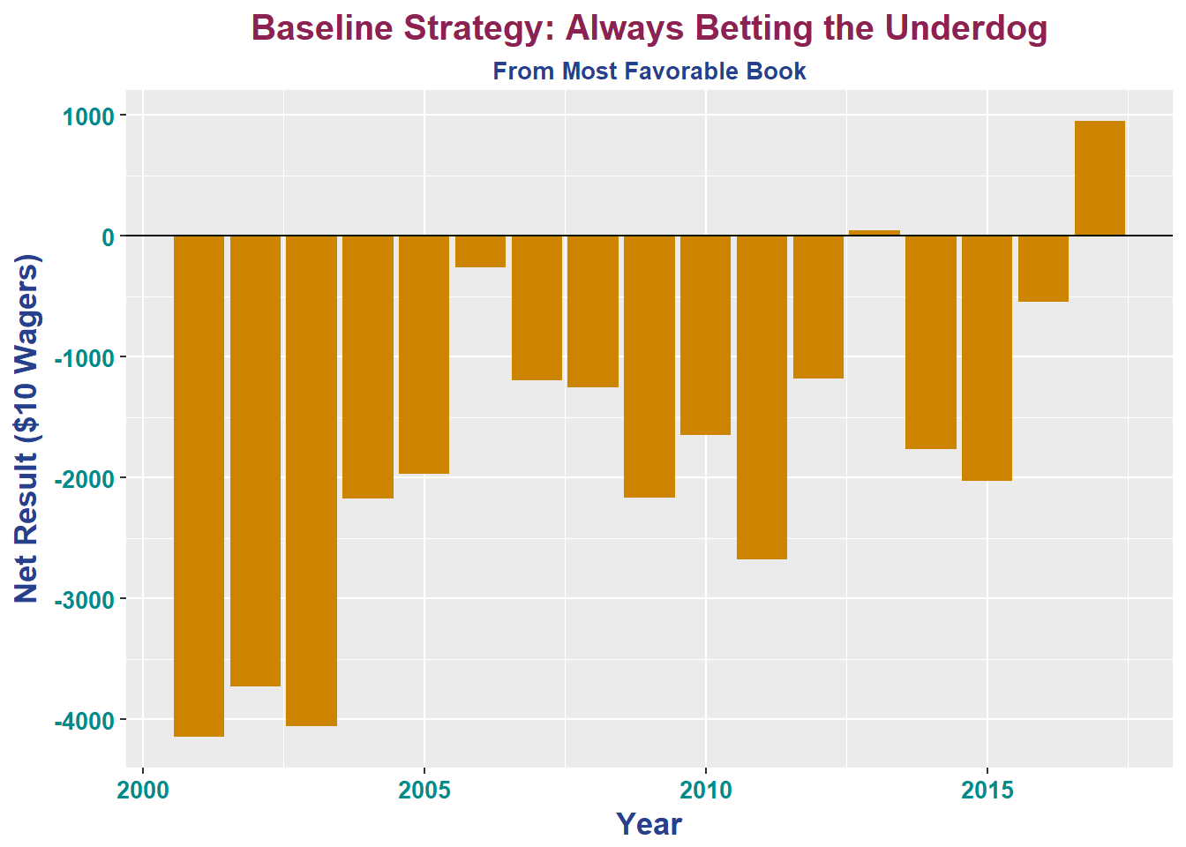
Baseline: Always Bet the Underdog

Slide 8
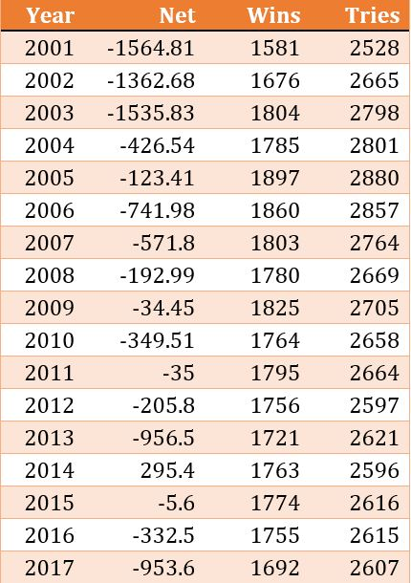
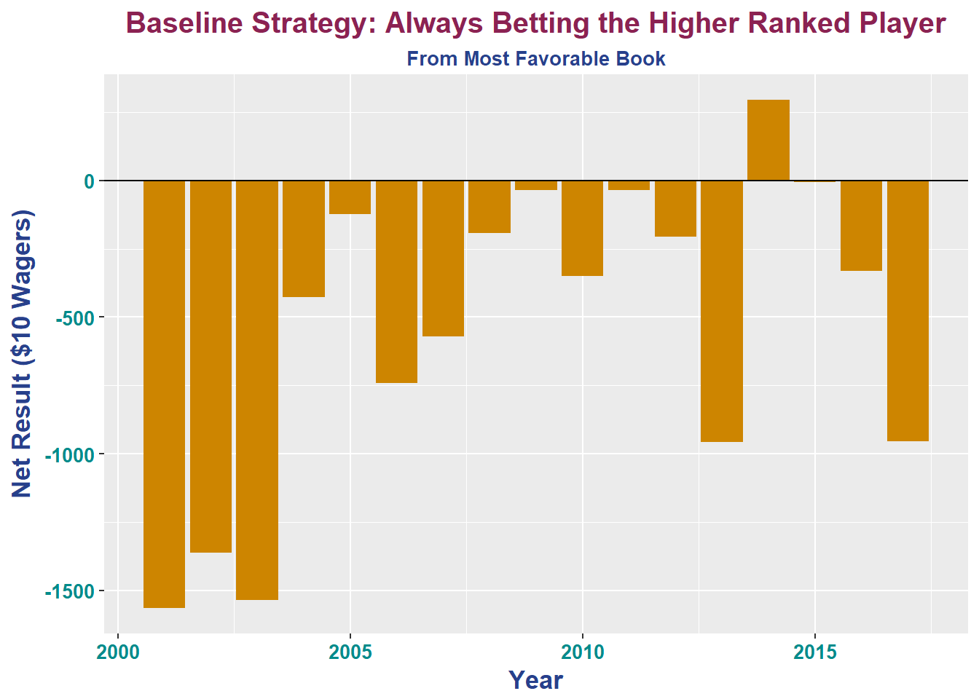
Baseline: Always Bet on Higher Rank

Slide 9
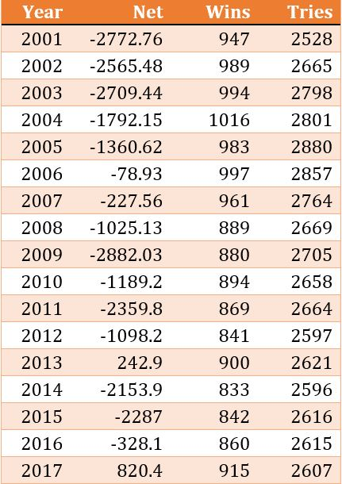
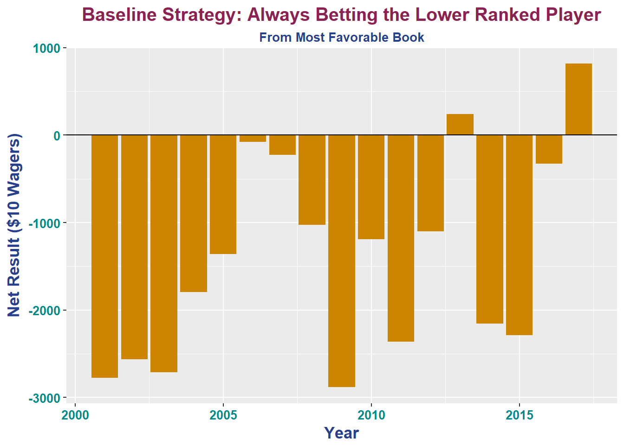
Baseline: Always Bet on Lower Rank

Slide 10
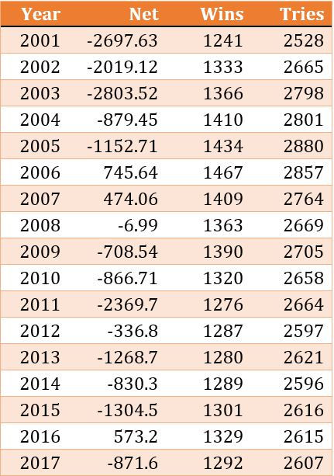
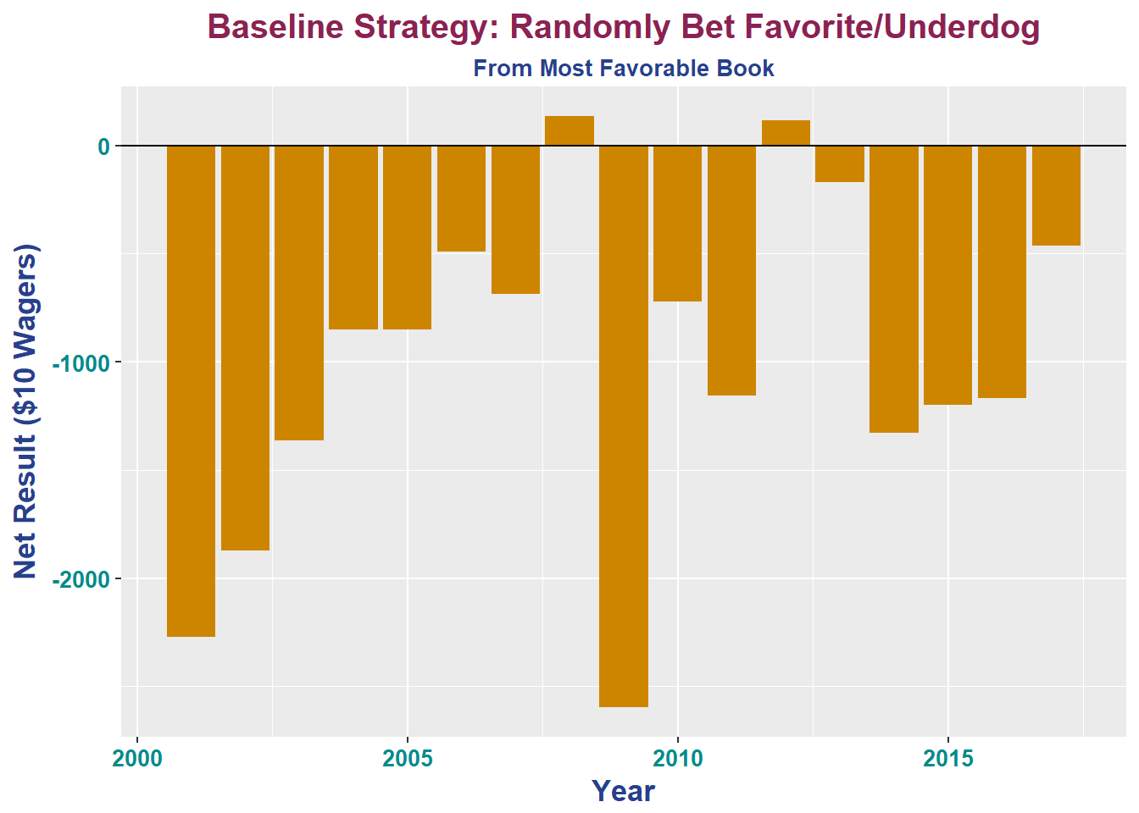
Baseline: Random Choices Between Favorite and Underdog

Slide 11
Baseline Strategy Results from 2001 through 2017
Strategy | Net Profit | Number of Wins | Number of Bets | Win Percentage
Favorite | -3,087.51 | 31,951 | 45,641 | 0.7000504
Underdog | -29,777.09 | 13,690 | 45,641 | 0.2999496
Random Choice | -15,255.30 | 22,832 | 45,641 | 0.500252
Higher Rank | -9,097.60 | 30,031 | 45,641 | 0.657983
Lower Rank | -23,767.00 | 15,610 | 45,641 | 0.342017

Slide 12
Testing Data Exploration & Analysis
Upset Frequencies
New Metric: Payout-Potential
Payout-Potential = P(successful bet) * (average odds|success)
The idea is to indicate the average return or loss per $1 wager.

Slide 13
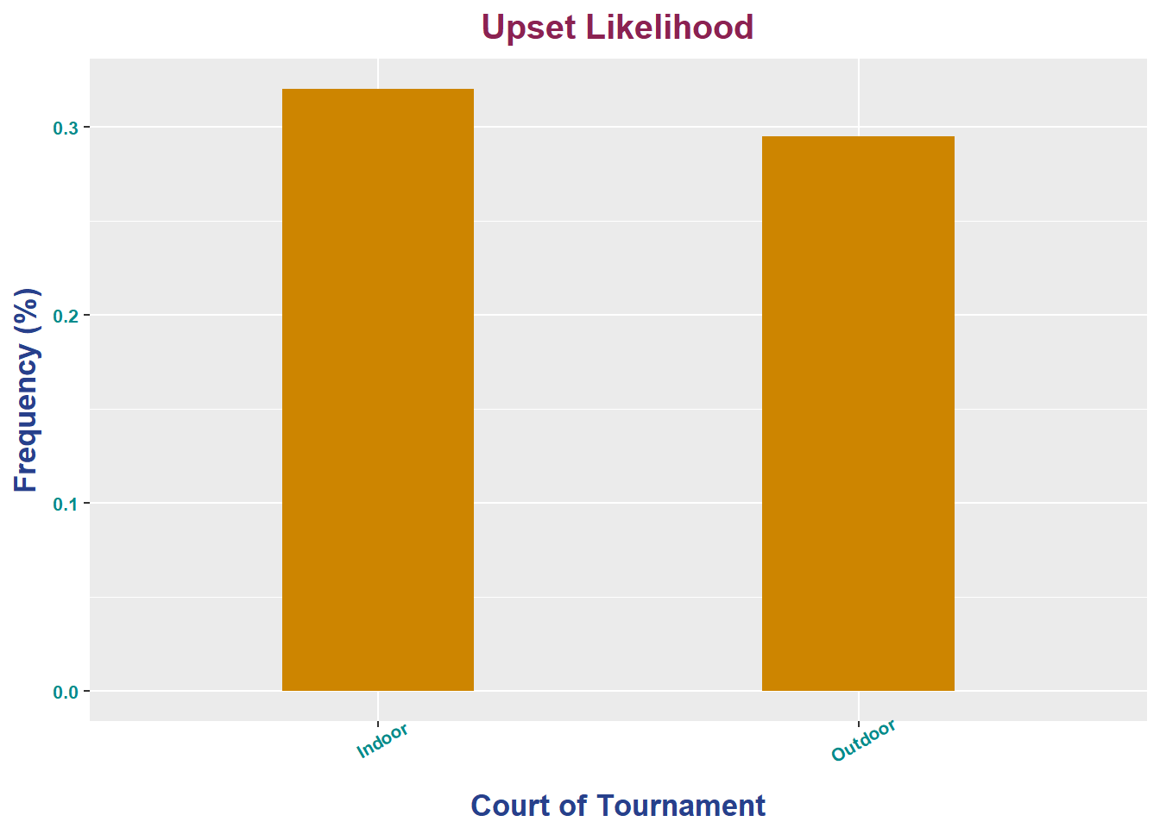
Exploratory: Upset Frequency by Indoor/Outdoor
Court | Upset Frequency | Number of Odds Upset | Total Number of Matches
Indoor | 0.3203769 | 2176 | 6792
Outdoor | 0.2950665 | 9091 | 30810

Slide 14
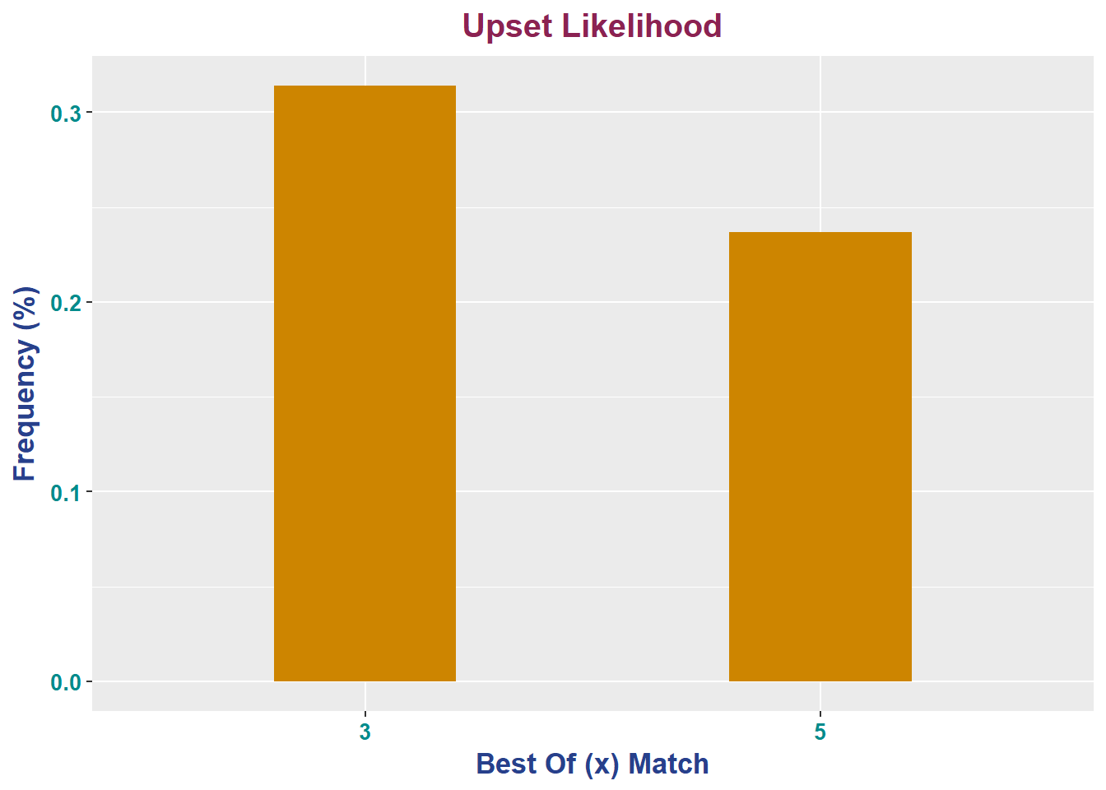
Exploratory: Upset Frequency by Match Type
Games per Match | Upset Frequency | Number of Odds Upset | Total Number of Matches
3 | 0.3141248 | 9594 | 30542
5 | 0.2369688 | 1673 | 7060

Slide 15
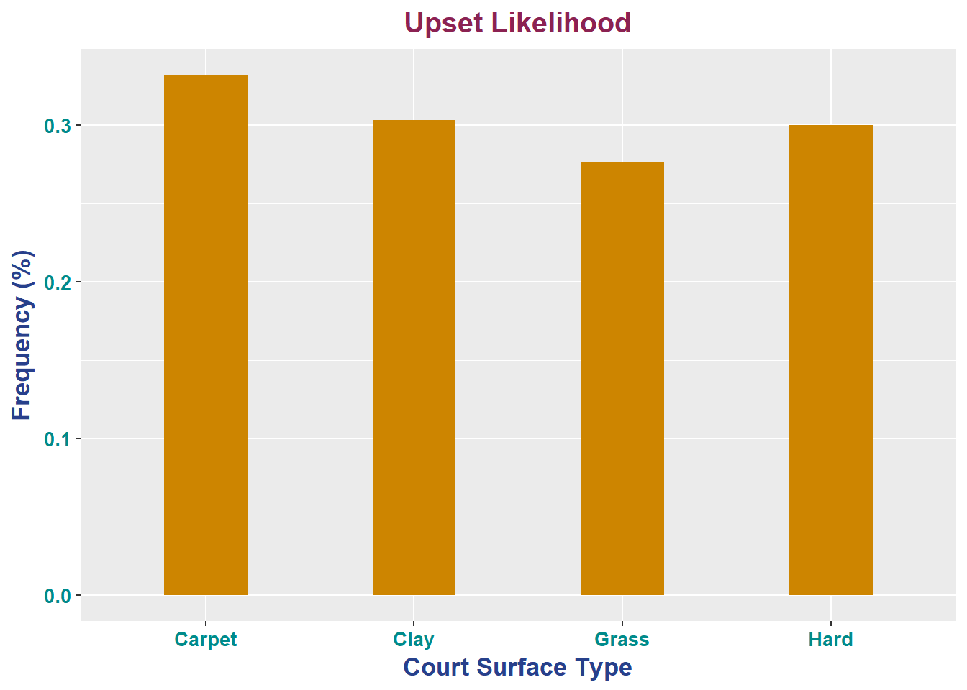
Exploratory: Upset Frequency by Court Surface Type
Surface | Upset Frequency | Number of Odds Upset | Total Number of Matches
Carpet | 0.3320106 | 502 | 1512
Clay | 0.3029841 | 3777 | 12466
Grass | 0.2766467 | 1155 | 4175
Hard | 0.2999126 | 5833 | 19449

Slide 16
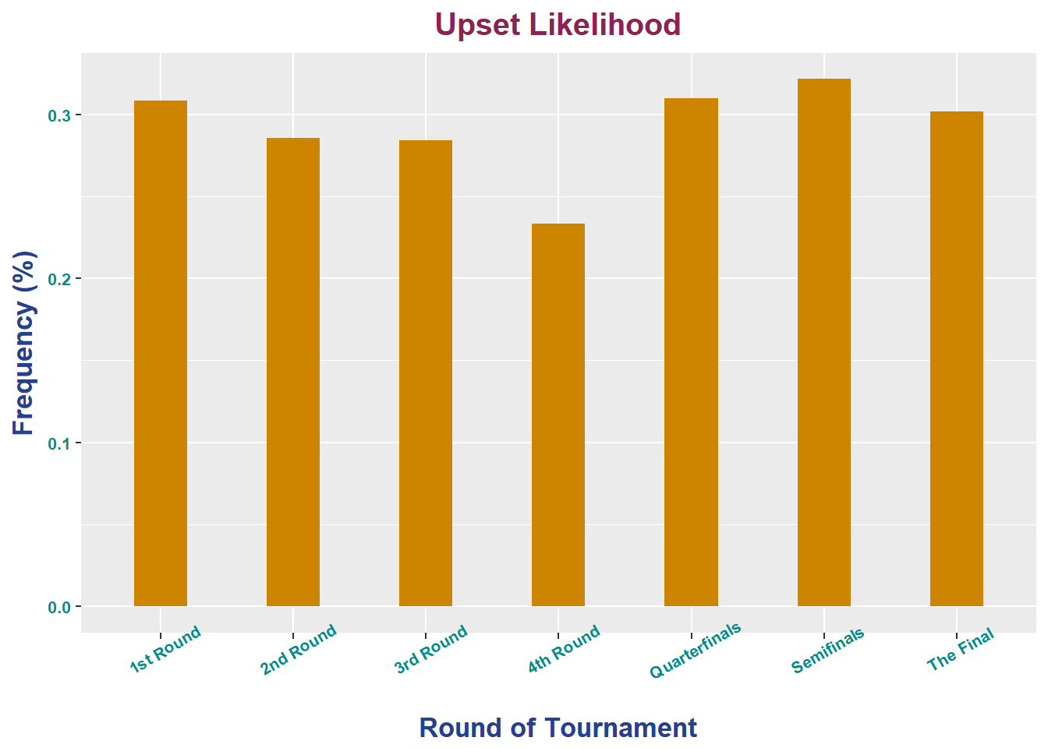
Exploratory: Upset frequency by Round of Tournament
Round | Upset Frequency | Number of Odds Upset | Total Number of Matches
1st Round | 0.3084771 | 5382 | 17447
2nd Round | 0.2856053 | 2996 | 10490
3rd Round | 0.2842993 | 775 | 2726
4th Round | 0.2333849 | 151 | 647
Quarterfinals | 0.3098827 | 1110 | 3582
Semifinals | 0.3213694 | 582 | 1811
The Final | 0.3014461 | 271 | 899

Slide 17
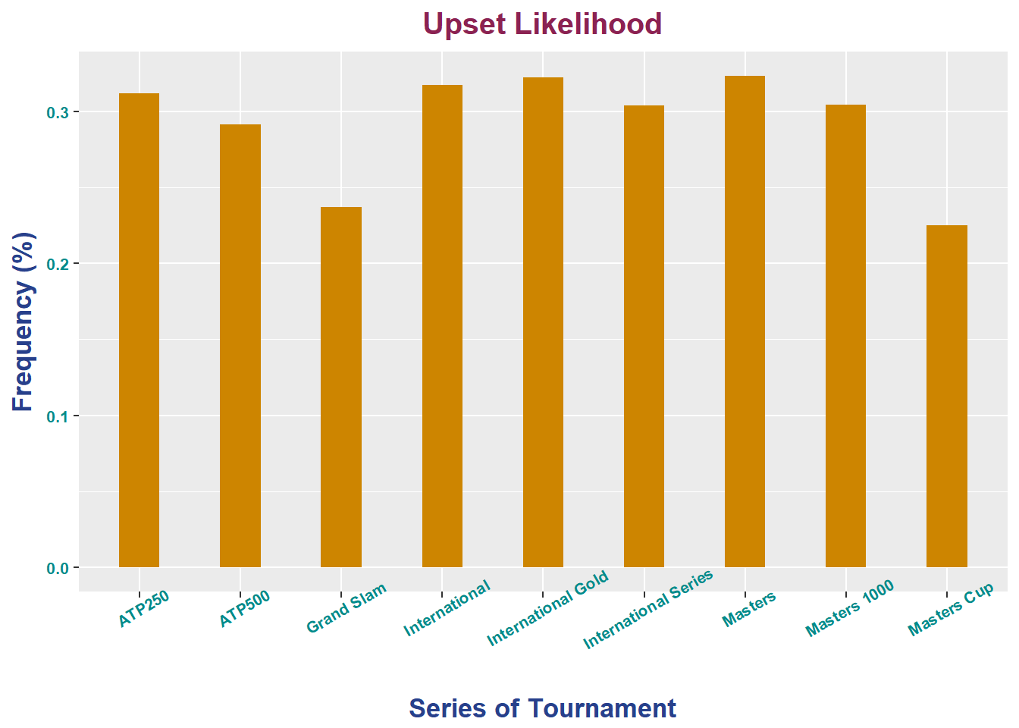
Exploratory: Upset Frequency by Tournament Series
Series | Upset Frequency | Number of Odds Upset | Total Number of Matches
ATP250 | 0.3121047 | 2171 | 6956
ATP500 | 0.2914311 | 670 | 2299
Grand Slam | 0.2369438 | 1656 | 6989
International | 0.3173018 | 3114 | 9814
International Gold | 0.3222257 | 1025 | 3181
International Series | 0.3040201 | 121 | 398
Masters | 0.3233455 | 1500 | 4639
Masters 1000 | 0.3046257 | 1001 | 3286
Masters Cup | 0.225 | 9 | 40

Slide 18
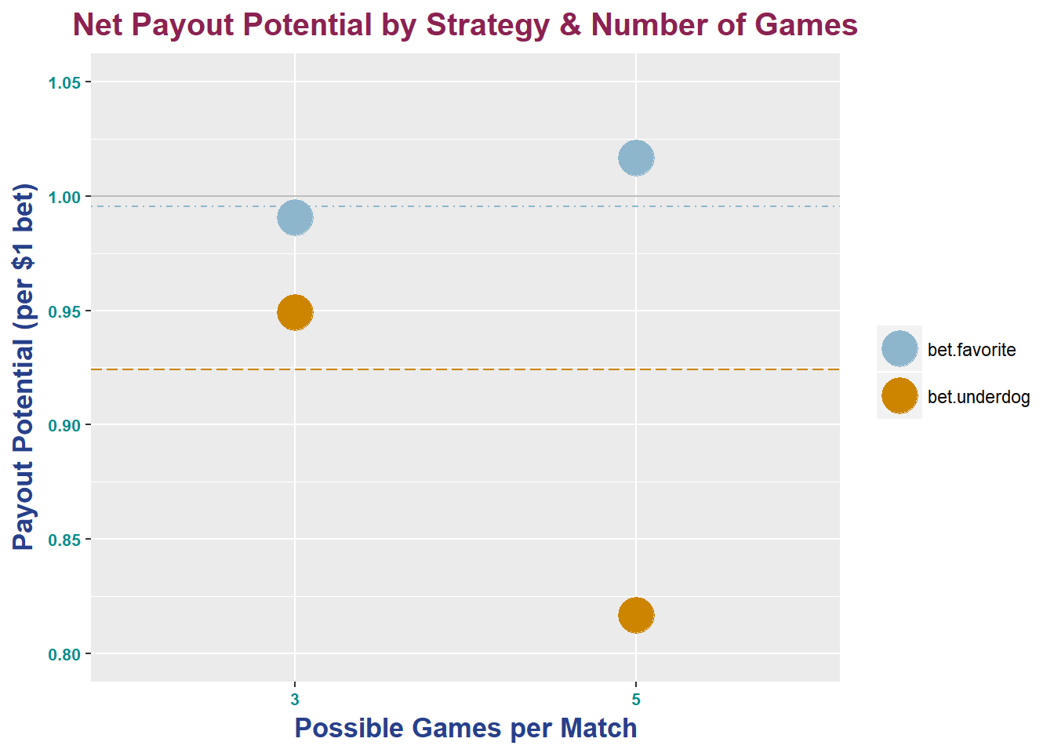
Exploratory: Payout-Potential by Match Type

Slide 19
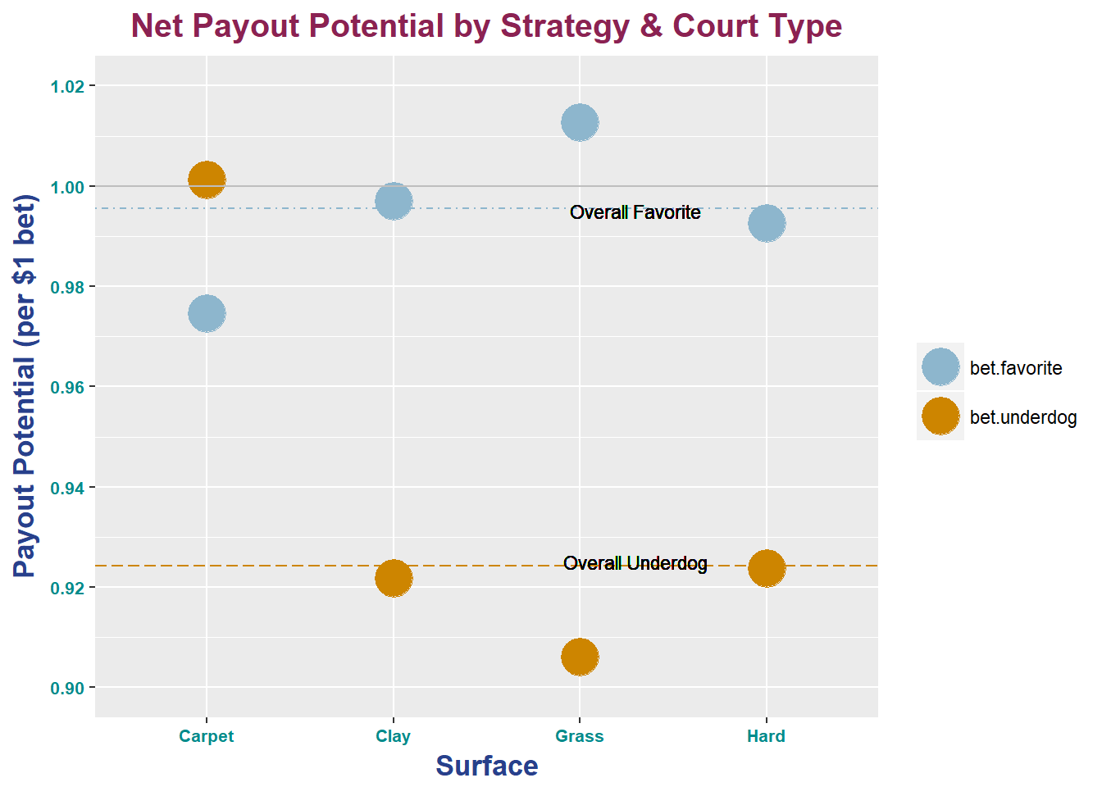
Exploratory: Payout-Potential by Court Surface Type

Slide 20
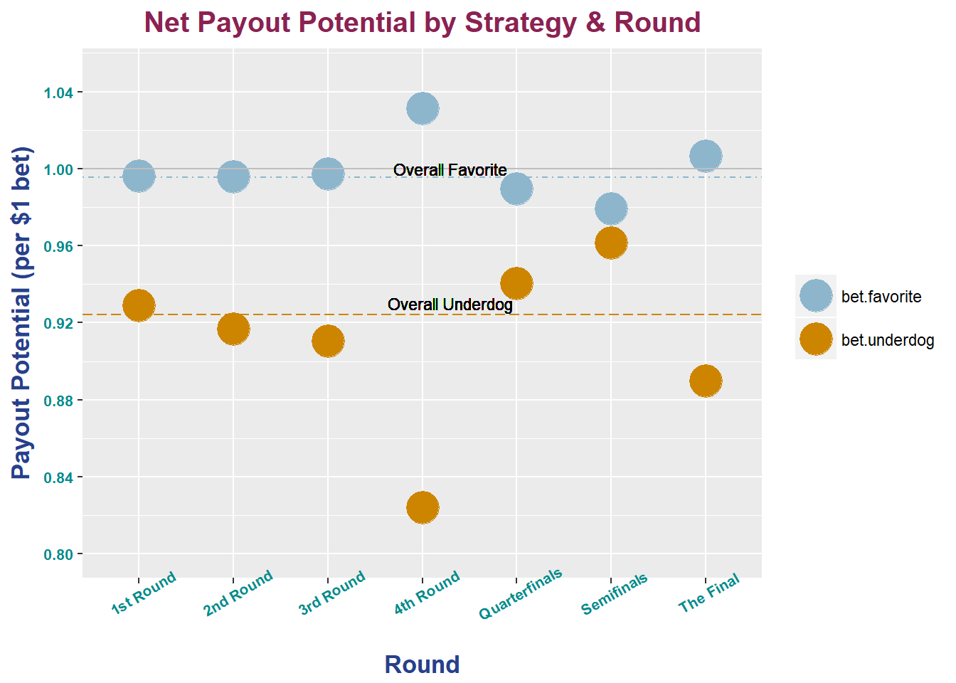
Exploratory: Payout Potential by Round of Tournament

Slide 21
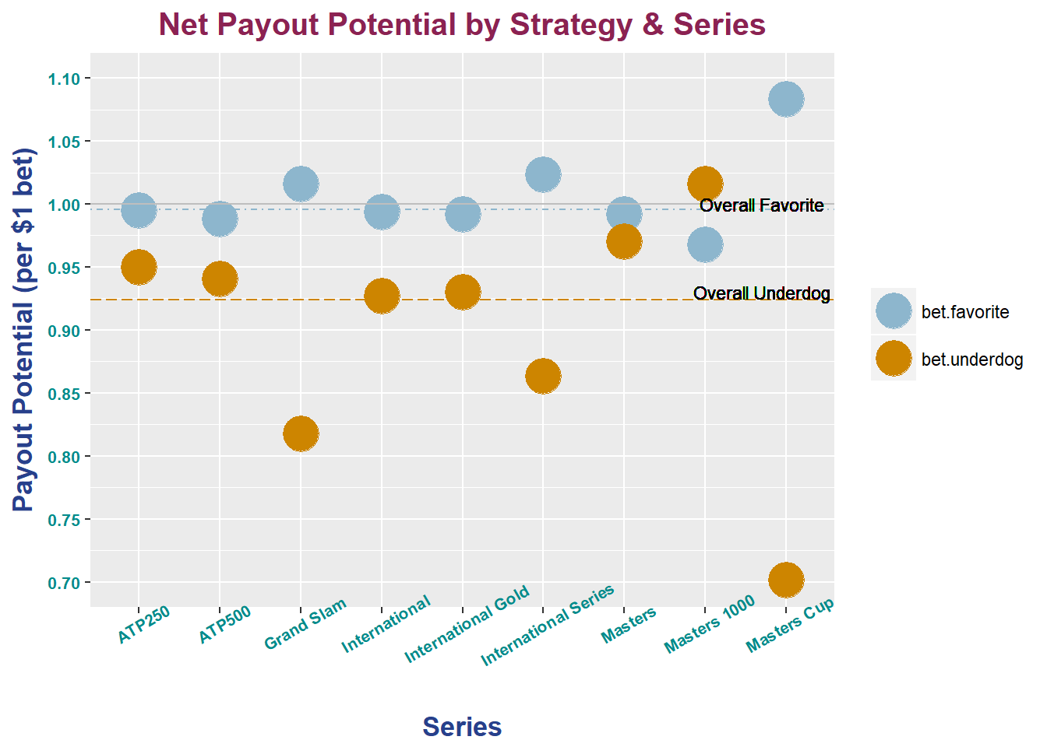
Exploratory: Payout Potential by Tournament Series

Slide 22
Informed Betting Strategies
Simulations over Testing Data
Training: 2001-2014
Training: 2015-2017
Strategies
Method conditional on payout-potential variable
Method based on logistic model for select players
Other advanced methods

Slide 23
Betting Strategy Based on Payout Potential from Training Data
Series with payout potential > 1
Betting the favorite
Grand Slam, International Series, Masters Cup
Betting the underdog
Masters 1000
Match type with payout potential > 1
Betting the favorite
5
Betting the underdog
None
Surface type with payout potential > 1
Betting the favorite
Grass
Betting the underdog
Carpet
Round with payout potential > 1
Betting the favorite
4th round, final
Betting the underdog
None
Strategy:
If any condition of the match is met for betting the underdog
=> bet the underdog
Else, if any condition of the match is met for betting the favorite
=> bet the favorite
Else, if no conditions are met for either
=> don’t place a wager

Slide 24
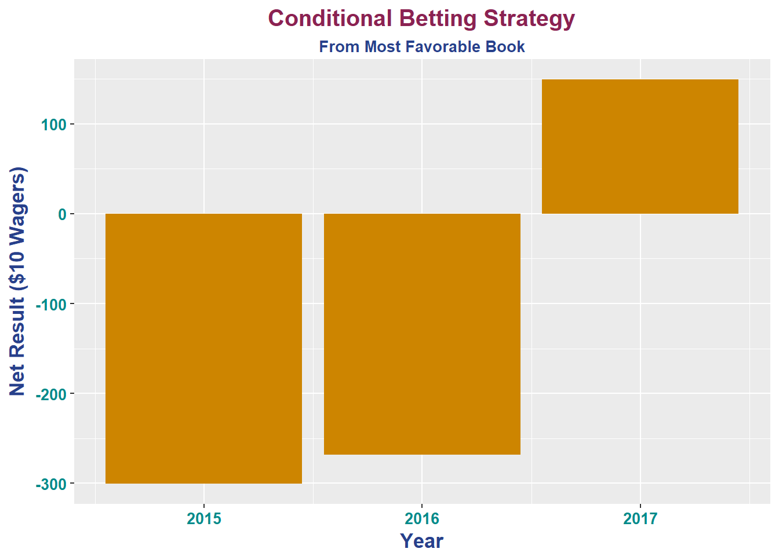
Simulation of Strategy Based On Payout Potential
Year | Net Profit | Wins | Tries
2015 | -300.60 | 126 | 230
2016 | -268.50 | 123 | 230
2017 | 149.70 | 139 | 234

Slide 25
Single-Player Logistic Regression Betting Strategy
Create logistic regression with response as the outcome
Predictors in logistic regression
Bet on matches that regression predicts probability of winning greater than threshold
Goal of strategy:
Bet when you are most confident
Used 2001-2014 seasons as training data
Simulated for 2015, 2016, and 2017 seasons with $10 wager
Players in current top 15 older than 29.
Notes:
-created a logistic regression with the response variable being the outcome of the match for a given player.
-predictors of the logistic of regression were variables such as the difference in rank between the players, surface type, odds of winning, and the series type the match occurred in.
-talk about reason for doing single player for these variables. -bet on matches that regression predicts that the player has a probability of winning greater than some threshold.
-the goal of this strategy is to bet when you are most confident and be more accurate in your bets.

Slide 26
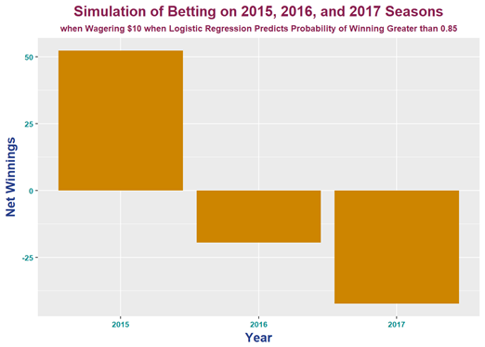
Probability Threshold of 0.85
 | Net Profit | Number of Wins | Number of Bets | Win Percentage
Rafael Nadal | -37.15 | 97 | 111 | 0.8739
Roger Federer | 6.06 | 91 | 98 | 0.9286
Novak Djokovic | -1.50 | 151 | 162 | 0.9321
Stan Wawrinka | 27.00 | 28 | 28 | 1.0000
Juan Martin del Potro | -5.40 | 14 | 17 | 0.8235
Marin Cilic | -27.95 | 29 | 35 | 0.8286
Sam Queery | 31.80 | 4 | 4 | 1.0000
Kevin Anderson | 1.58 | 12 | 14 | 0.8571
Jo-Wilfried Tsonga | -4.03 | 27 | 30 | 0.9000
Total | -9.58 | 453 | 499 | 0.9078

Slide 27
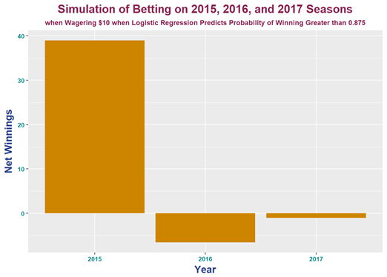
Probability Threshold of 0.875
 | Net Profit | Number of Wins | Number of Bets | Win Percentage
Rafael Nadal | -12.28 | 88 | 98 | 0.8980
Roger Federer | -0.20 | 83 | 89 | 0.9326
Novak Djokovic | -6.33 | 134 | 143 | 0.9371
Stan Wawrinka | 12.61 | 16 | 16 | 1.0000
Juan Martin del Potro | -4.50 | 11 | 13 | 0.8462
Marin Cilic | 6.23 | 18 | 19 | 0.9473
Sam Queery | 31.80 | 4 | 4 | 1.0000
Kevin Anderson | 1.58 | 12 | 14 | 0.8571
Jo-Wilfried Tsonga | 2.48 | 25 | 27 | 0.9259
Total | 31.38 | 391 | 423 | 0.9243

Slide 28
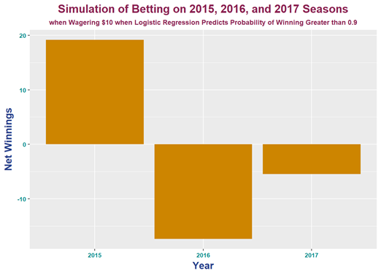
Probability Threshold of 0.9
 | Net Profit | Number of Wins | Number of Bets | Win Percentage
Rafael Nadal | -23.41 | 80 | 89 | 0.8989
Roger Federer | -8.35 | 68 | 73 | 0.9315
Novak Djokovic | -17.67 | 93 | 99 | 0.9394
Stan Wawrinka | 3.96 | 6 | 6 | 1.0000
Juan Martin del Potro | -0.05 | 6 | 7 | 0.8571
Marin Cilic | 7.63 | 8 | 8 | 1.0000
Sam Queery | 26.73 | 2 | 2 | 1.0000
Kevin Anderson | 5.45 | 9 | 10 | 0.9000
Jo-Wilfried Tsonga | 2.08 | 16 | 17 | 0.9412
Total | -3.64 | 288 | 311 | 0.9260

Slide 29
Conclusion on Single-Player
Logistic Regression Betting Strategy
Betting strategy only profits with threshold of 0.875
Models have predictive power of outcome of match
Payoff of being correct is small for correct bets
Not much room for profit in “safe” matches
May be more effective with varying bets

Slide 30
Machine learning methods
Logistic Regression
SVM
Random Forest
Adaboost

Slide 31
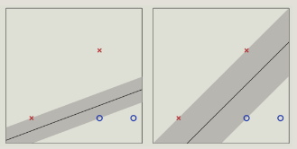
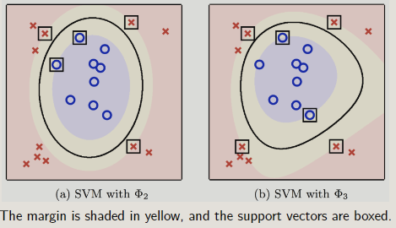
SVM

Slide 32
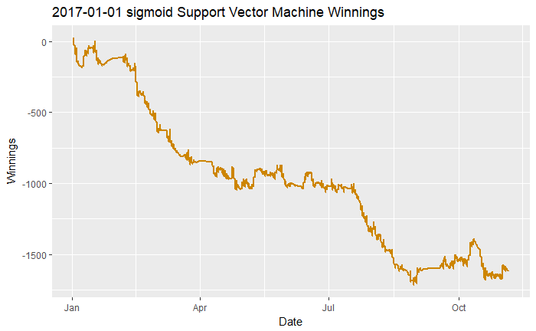
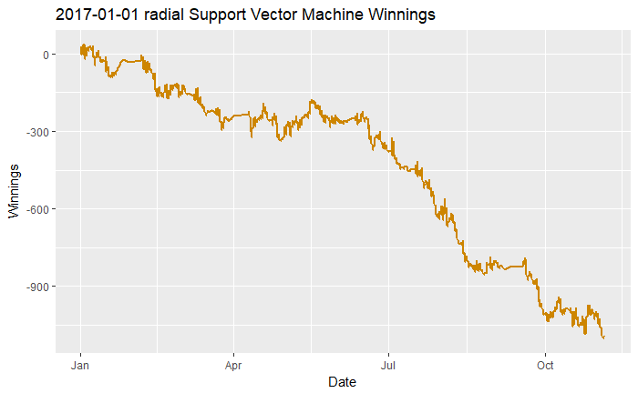
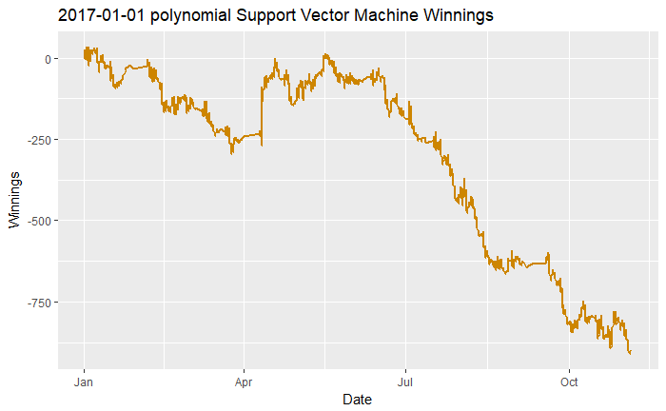

SVM

Slide 33
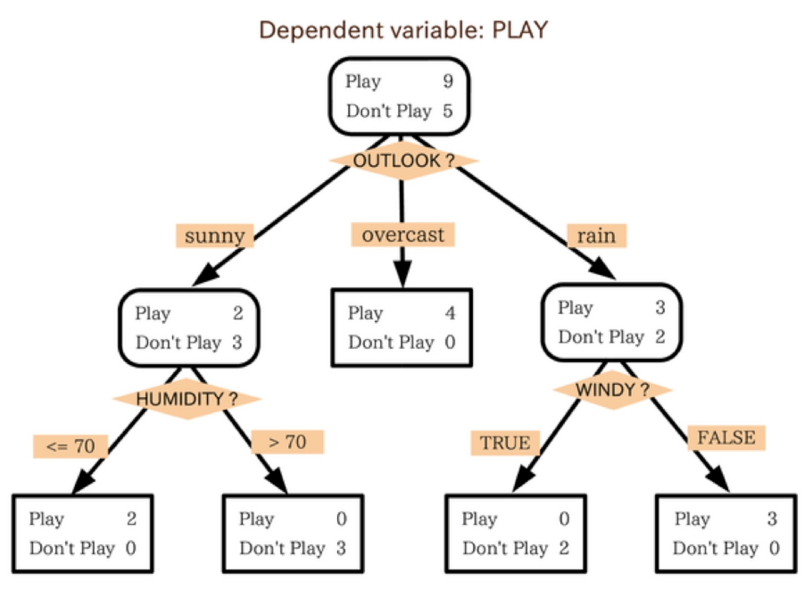
Random Forest & Adaboost
Adaboost
Boosting Algorithm
Iterative
Learns from past iterations
Random Forest
Ensemble Method
Randomly selects many trees
Averages
Notes:
Both tree methods, aggregate differently. Adaboost isn’t just for trees, but trees work well and are implemented in R
...most boosting algorithms consist of iteratively learning weak classifiers with respect to a distribution and adding them to a final strong classifier. When they are added, they are typically weighted in some way that is usually related to the weak learners' accuracy. After a weak learner is added, the data is reweighted...
An example of this iterative process is adaboost, whereby weaker results are boosted or reweighted over many iterations to have the learner focus more on areas it got wrong, and less on those observations that were correct.
A random forest, in contrast, is an ensemble bagging or averaging method that aims to reduce the variance of individual trees by randomly selecting (and thus de-correlating) many trees from the dataset, and averaging them

Slide 34
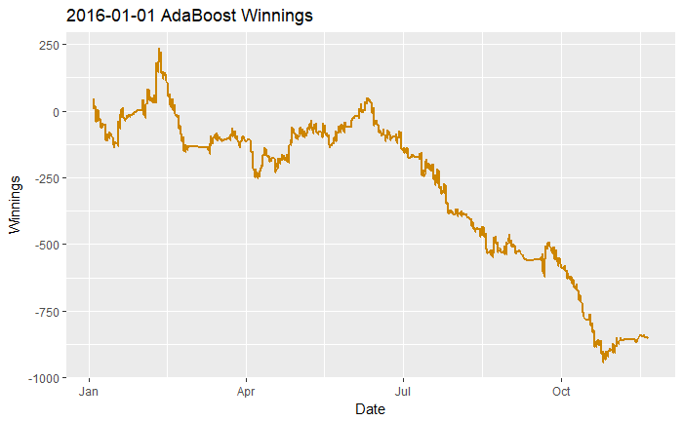
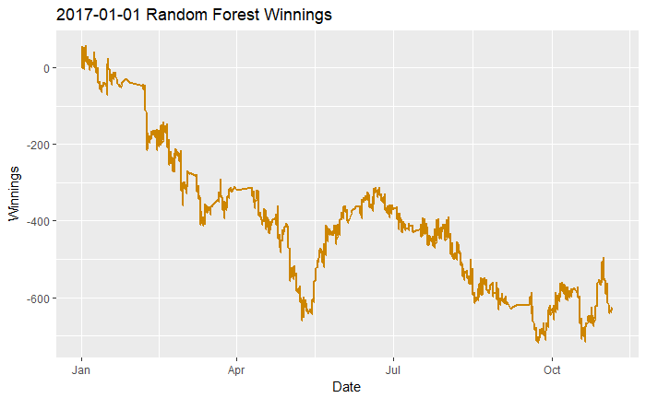
Random Forest & AdaBoost

Slide 35
Machine learning methods
Classification
Who will win? Bet on winner
True or False
Regression
If I bet on this guy, how much money will I make?
-10 - INF

Slide 36
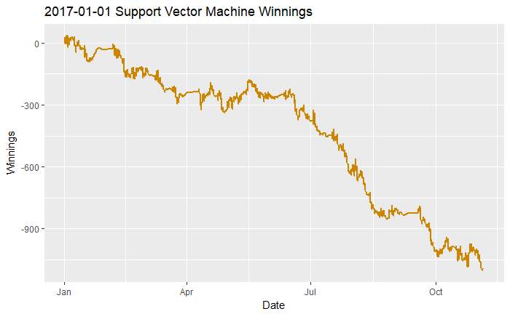
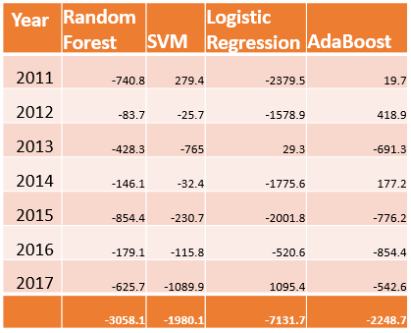
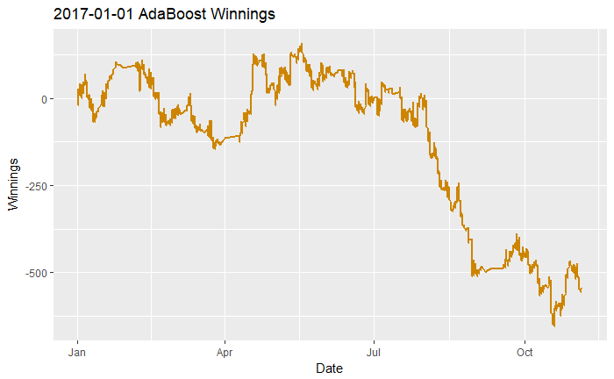
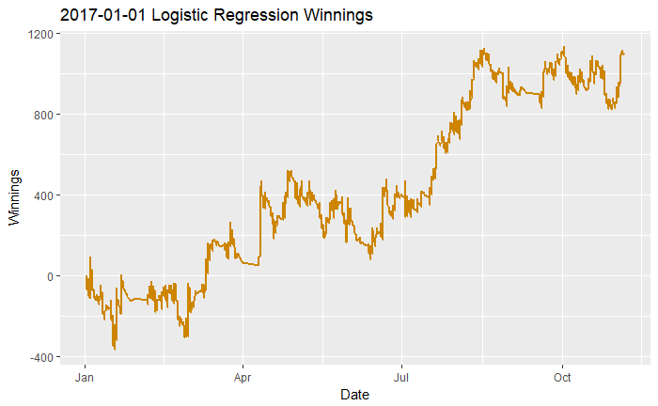
Classification
Winnings: Bet $10 on expected winner

Slide 37
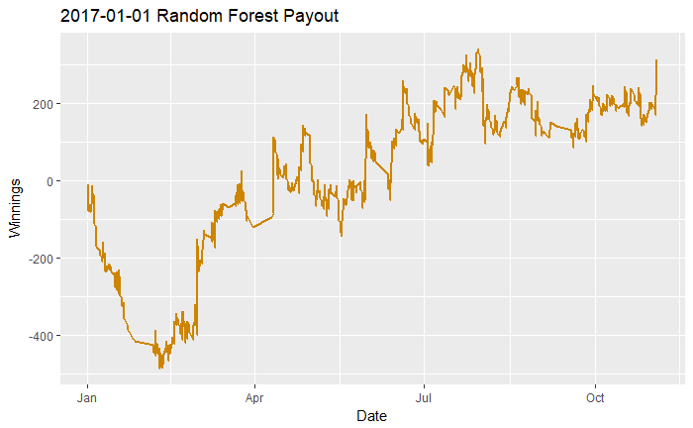
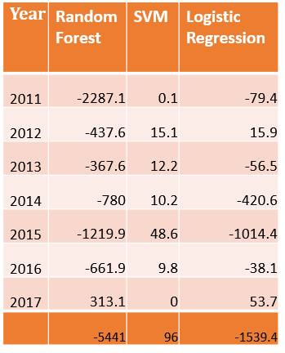
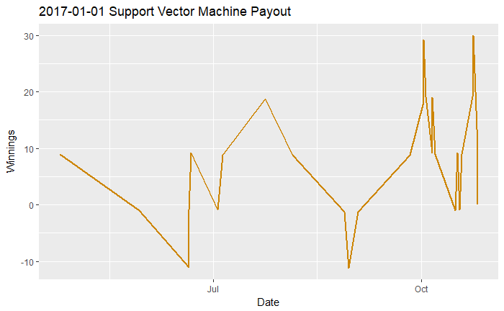
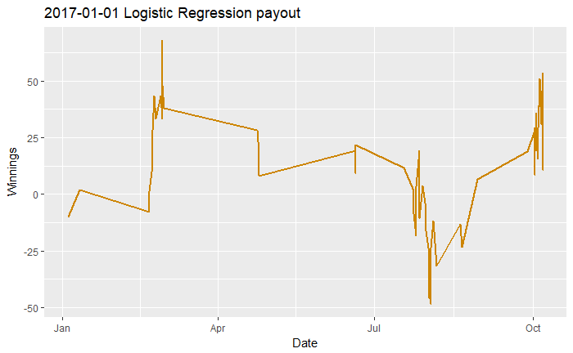
Regression
Winnings:
Bet $10 when expected payout > $2

Slide 38
Next Steps
Feature selection
Feature extraction
Model Tuning
Bet Variation

